Slide 1
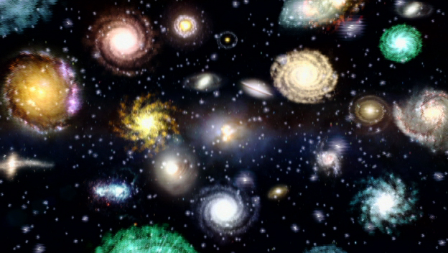
Theories of the universe
Ms. edwards
S6E1a. Relate the Nature of Science to the progression of basic historical scientific models (geocentric, heliocentric) as they describe our solar system, and the Big Bang as it describes the formation of the universe.
Notes:
Instructional Approach(s): Introduce the essential question and the standard for the lesson.

Slide 2
The Big Bang Theory
The most commonly accepted theory today of the formation of the universe is the Big Bang Theory.
The theory states that the universe originated sometime between 10 billion and 20 billion years ago from an enormous explosion of a small volume of matter at extremely high density and temperature.
after the Big Bang, dense clouds of gas and dust from the “bang” either collapsed or stuck together to form the parts of the universe we know today.

Slide 3
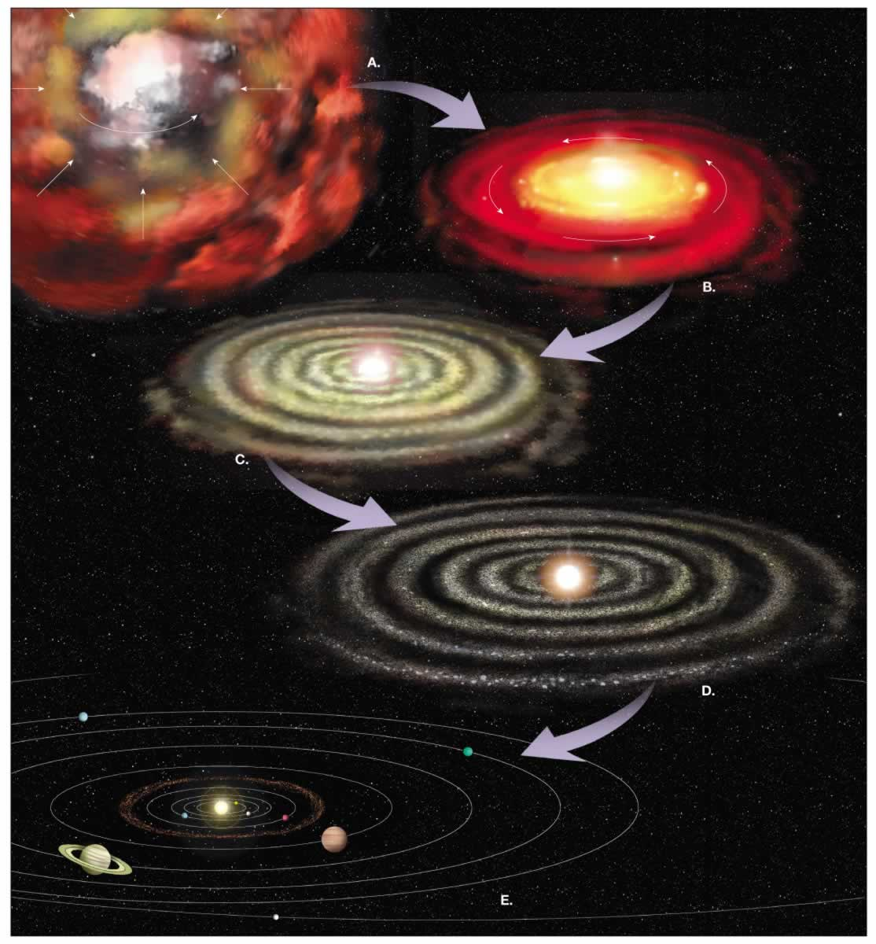
Notes:
Instructional Approach(s): Teacher uses the picture to show how the universe was formed over time in the Big Bang Theory

Slide 4
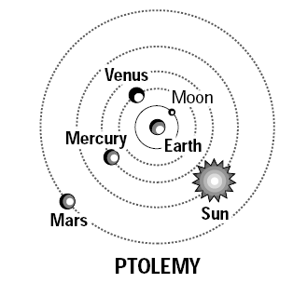
Ptolemy’s Model of the Solar System
Ptolemy’s theory is known as
the Geocentric Model because
he thought the Earth was the
center of the universe
He believed his theory for
several reasons
  Gravity of all objects were attracted to the earth, which suggested to him that the
  earth must be the center.
  He thought the Earth did not move because objects fell in
  the same place if thrown up in
  the air. He thought if the earth moved, objects would fall in a different place.

Slide 5
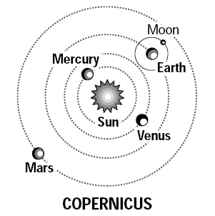
Copernicus’ Model of the Solar System
Copernicus’ theory is called the Heliocentric Theory because he thought the sun was the center of the universe.
Galileo made additional observations using a telescope which supported the heliocentric theory.
  Galileo observed that Venus went through a full cycle of phase’s like the Moon. This could only be explained if Venus were orbiting the Sun.

